Slide 1
Introduction to Big Data and NoSQL

Slide 2
What’s Big Data?
No single definition; here is from Wikipedia:
Big data is the term for a collection of data sets so large and complex that it becomes difficult to process using on-hand database management tools or traditional data processing applications.
The challenges include capture, storage, search, sharing, transfer, analysis, and visualization.

Slide 3
Introduction
Big Data may well be the Next Big Thing in the IT world.
Big data burst upon the scene in the first decade of the 21st century.
The first organizations to embrace it were online and startup firms. Firms like Google, eBay, LinkedIn, and Facebook were built around big data from the beginning.
Like many new information technologies, big data can bring about dramatic cost reductions, substantial improvements in the time required to perform a computing task, or new product and service offerings.

Slide 4
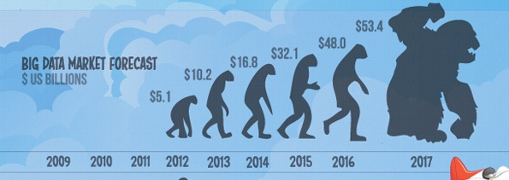
What is BIG DATA
Walmart handles more than 1 million customer transactions every hour.
• Facebook handles 40 billion photos from its user base.
• Decoding the human genome originally took 10years to process; now it can be achieved in one week.

Slide 5
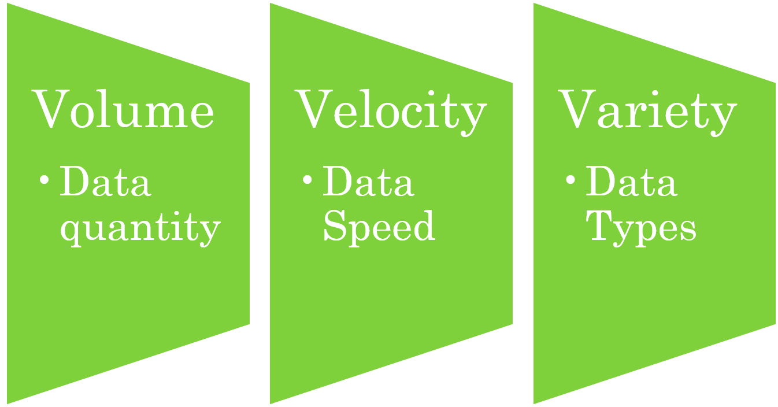
Three Characteristics of Big Data V3s

Slide 6
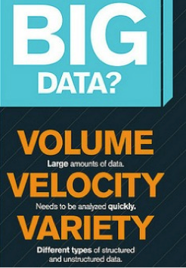

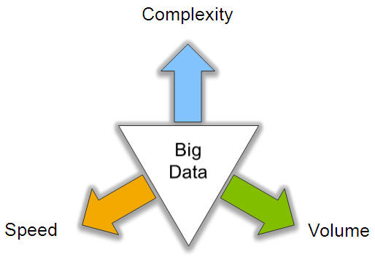
Big Data: 3V’s

Slide 7



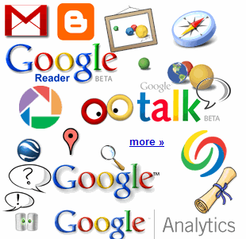

4.6 billion camera phones world wide
30 billion RFID tags today (1.3B in 2005)
12+ TBs of tweet data every day
100s of millions of GPS enabled devices sold annually
? TBs of data every day
25+ TBs of log data every day
2+ billion people on the Web by end 2011
76 million smart meters in 2009… 200M by 2014

Slide 8
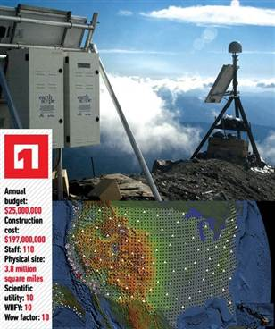
The Earthscope
1.
The Earthscope is the world's largest science project. Designed to track North America's geological evolution, this observatory records data over 3.8 million square miles, amassing 67 terabytes of data. It analyzes seismic slips in the San Andreas fault, sure, but also the plume of magma underneath Yellowstone and much, much more.

Slide 9
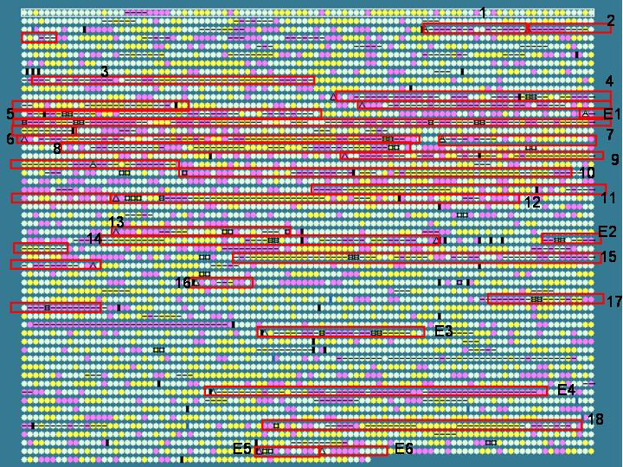
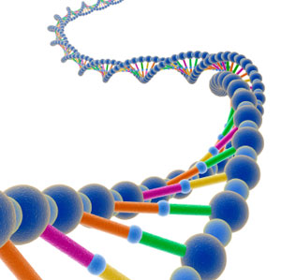
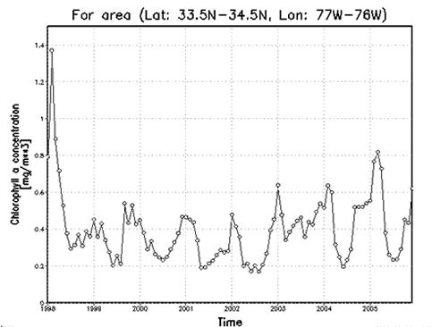

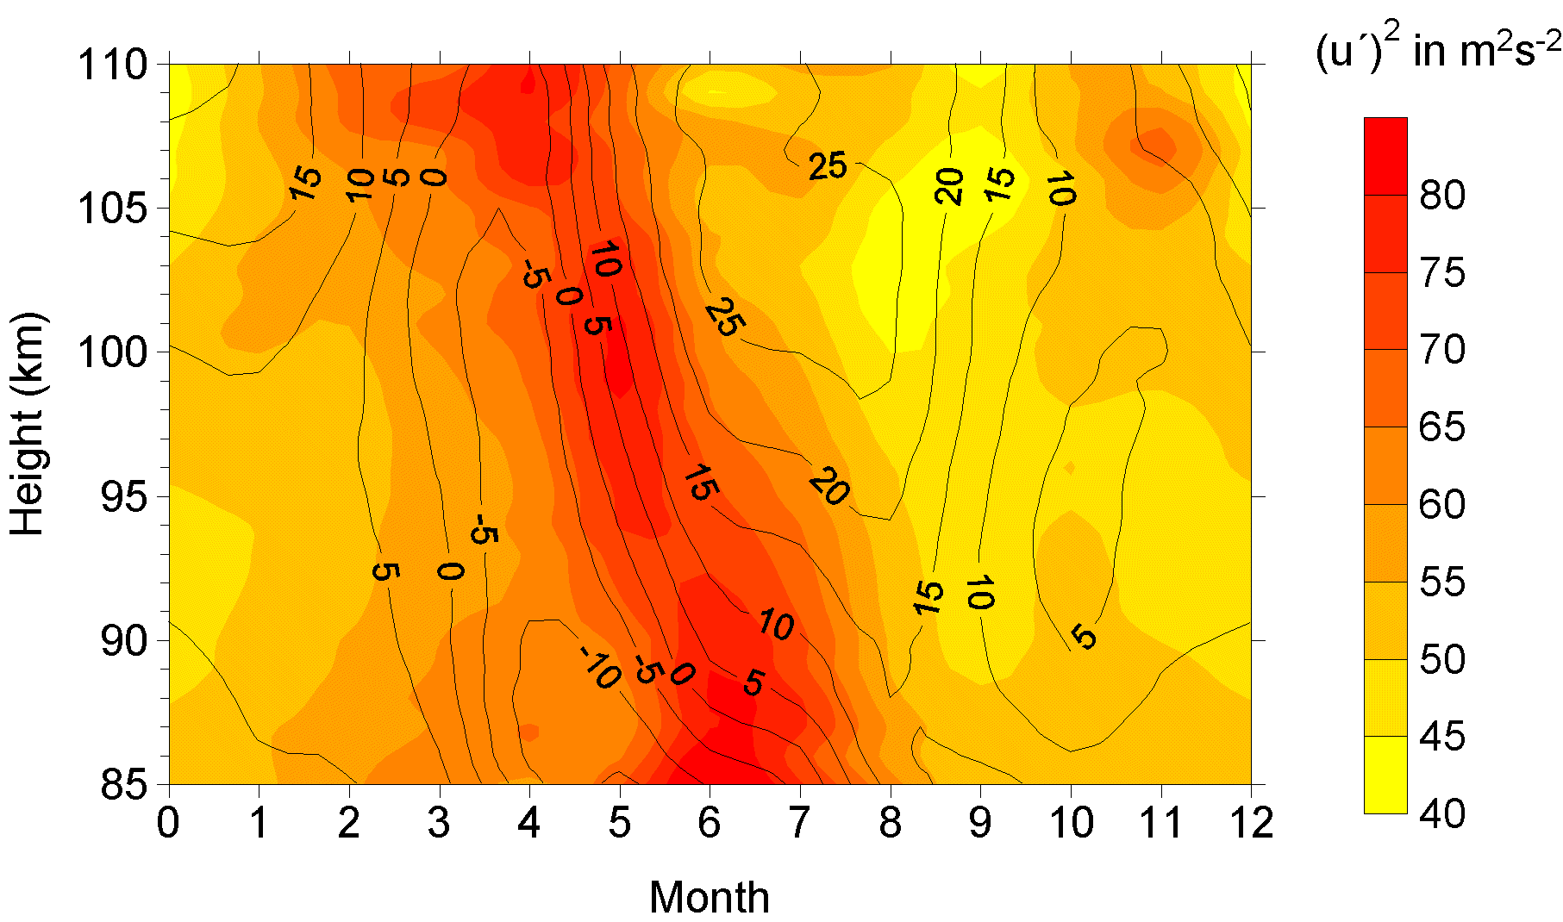
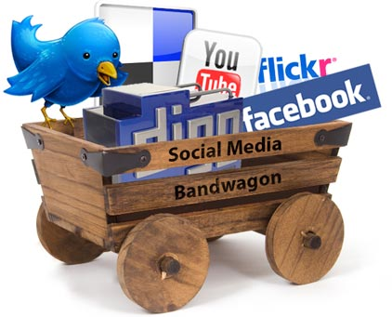
Variety (Complexity)
Relational Data (Tables/Transaction/Legacy Data)
Text Data (Web)
Semi-structured Data (XML)
Graph Data
Social Network, Semantic Web (RDF), …
Streaming Data
You can only scan the data once
A single application can be generating/collecting many types of data
Big Public Data (online, weather, finance, etc)
To extract knowledge➔ all these types of data need to linked together

Slide 10

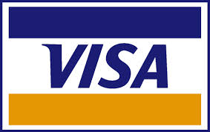







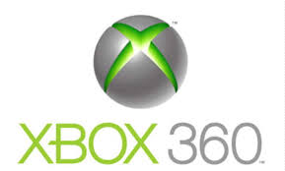






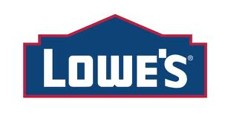
A Single View to the Customer
Social Media
Banking
Finance
Gaming
Our
Known
History
Customer
Entertain
Purchase

Slide 11

Velocity (Speed)
Data is begin generated fast and need to be processed fast
Online Data Analytics
Late decisions ➔ missing opportunities
Examples
E-Promotions: Based on your current location, your purchase history, what you like ➔ send promotions right now for store next to you
Healthcare monitoring: sensors monitoring your activities and body ➔ any abnormal measurements require immediate reaction

Slide 12
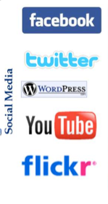


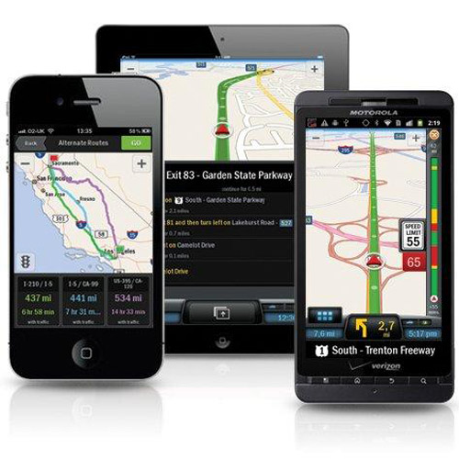

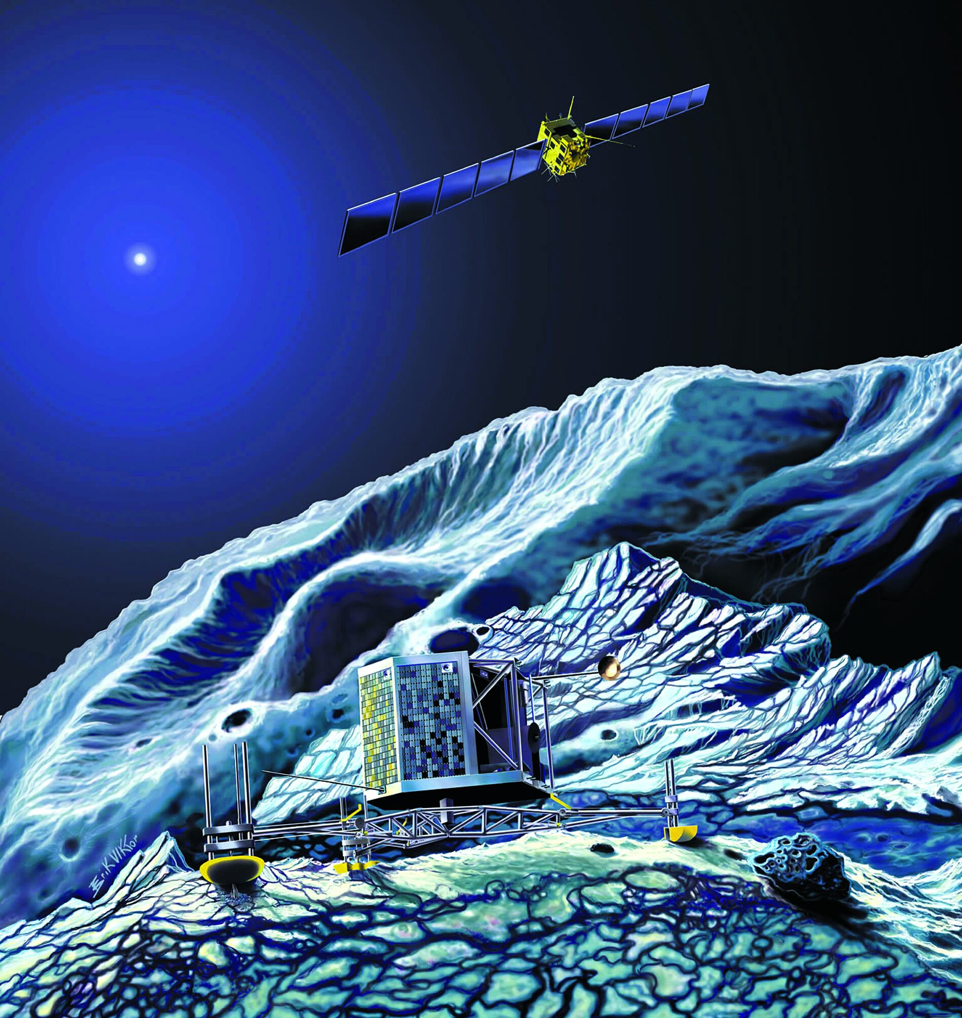
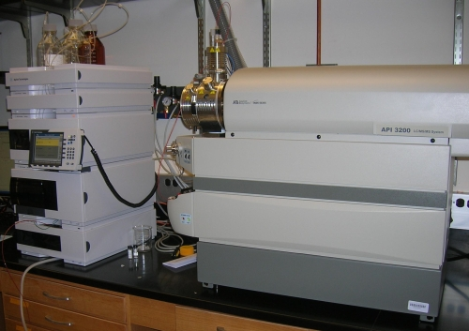
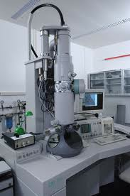
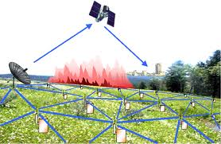
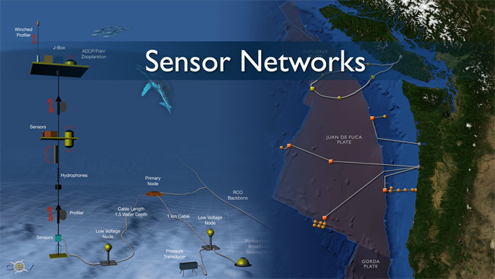
Real-time/Fast Data
Mobile devices
(tracking all objects all the time)
Social media and networks
(all of us are generating data)
Scientific instruments
(collecting all sorts of data)
Sensor technology and networks
(measuring all kinds of data)
The progress and innovation is no longer hindered by the ability to collect data
But, by the ability to manage, analyze, summarize, visualize, and discover knowledge from the collected data in a timely manner and in a scalable fashion

Slide 13
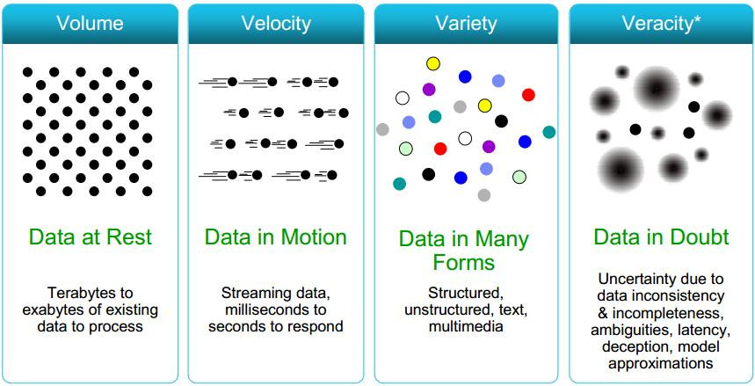
Some Make it 4V’s

Slide 14
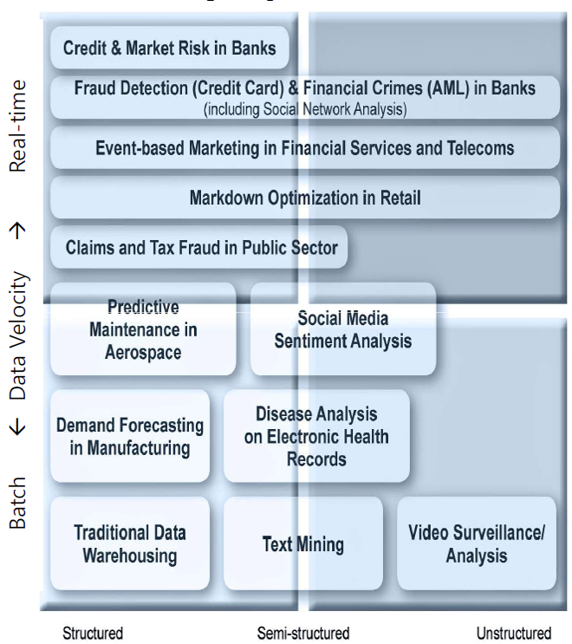
The Structure of Big Data
Structured
Most traditional data sources
Semi-structured
Many sources of big data
Unstructured
Video data, audio data

Slide 15
Why Big Data
Growth of Big Data is needed
Increase of storage capacities
Increase of processing power
Availability of data(different data types)
Every day we create 2.5 quintillion bytes of data; 90% of the data in the world today has been created in the last two years alone

Slide 16
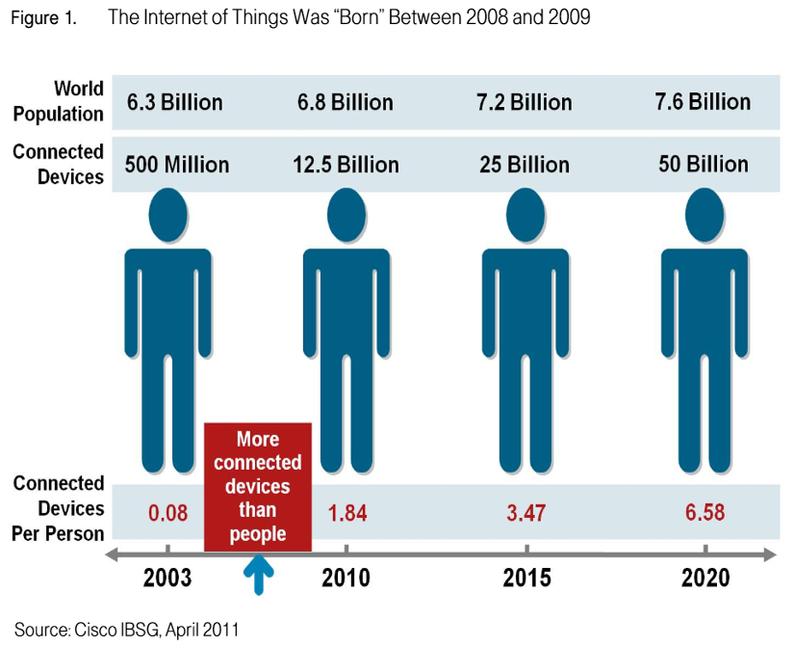
Why Big Data
FB generates 10TB daily
Twitter generates 7TB of dataDaily
IBM claims 90% of today’s stored data
was generated in just the last two years.

Slide 17
Applications
Smarter Healthcare
Traffic Control
Manufacturing
Multi-channel sales
Telecom
Trading Analytics
Search Quality

Slide 18
NoSQL
NoSQL is an approach to database design that can accommodate a wide variety of data models, including key-value, document, columnar and graph formats.
NoSQL, which stand for "not only SQL," is an alternative to traditional relational databases in which data is placed in tables and data schema is carefully designed before the database is built.
NoSQL databases are especially useful for working with large sets of distributed data.

Slide 19
Major issues of Relational Databases
Relational databases were designed for tabular data, with a consistent structure and a fixed schema. They work best for problems that are well defined at the outset. But not good to manage unstructued data.
A Large Number of JOINs
When you utilize queries that join many different tables, there’s an explosion of complexity and computing resource consumption. This results in a corresponding increase in query response times.
Frequent Schema Changes
Slow-Running Queries (Despite Extensive Tuning)

Slide 20
What is NoSQL?
Stands for Not Only SQL
Class of non-relational data storage systems
Usually do not require a fixed table schema nor do they use the concept of joins
All NoSQL offerings relax one or more of the ACID properties (will talk about the CAP theorem)
Notes:
-> NoSQL was a term coined by Eric Evans. He states that ‘… but the whole point of seeking alternatives is that you need to solve a problem that relational databases are a bad fit for. …
-> This is why people are continually interpreting nosql to be anti-RDBMS, it's the only rational conclusion when the only thing some of these projects share in common is that they are not relational databases.’
-> Emil Elfrem stated it is not a ‘NO’ SQL but more of a ‘Not Only” SQL.

Slide 21
Why NoSQL
Document Oriented Storage: Data is stored in the form of JSON style documents.
Replication and high availability
Auto-sharding
Rich queries
Fast in-place updates

Slide 22
CAP Theorem
Three properties of a system: consistency, availability and partitions
You can have at most two of these three properties for any shared-data system
To scale out, you have to partition. That leaves either consistency or availability to choose from
In almost all cases, you would choose availability over consistency
Notes:
-> Proposed by Eric Brewer (talk on Principles of Distributed Computing July 2000).
-> Partitionability: divide nodes into small groups that can see other groups, but they can't see everyone. -> Consistency: write a value and then you read the value you get the same value back. In a partitioned system there are windows where that's not true. -> Availability: may not always be able to write or read. The system will say you can't write because it wants to keep the system consistent. -> To scale you have to partition, so you are left with choosing either high consistency or high availability for a particular system. You must find the right
overlap of availability and consistency.
-> Choose a specific approach based on the needs of the service. -> For the checkout process you always want to honor requests to add items to a shopping cart because it's revenue producing.
In this case you choose high availability. Errors are hidden from the customer and sorted out later. -> When a customer submits an order you favor consistency because several services--credit card processing, shipping and handling, reporting—
are simultaneously accessing the data.

Slide 23
Availability
Traditionally, thought of as the server/process available five 9’s (99.999 %).
However, for large node system, at almost any point in time there’s a good chance that a node is either down or there is a network disruption among the nodes.
Want a system that is resilient in the face of network disruption

Slide 24
Consistency Model
A consistency model determines rules for visibility and apparent order of updates.
For example:
Row X is replicated on nodes M and N
Client A writes row X to node N
Some period of time t elapses.
Client B reads row X from node M
Does client B see the write from client A?
Consistency is a continuum with tradeoffs
For NoSQL, the answer would be: maybe
CAP Theorem states: Strict Consistency can't be achieved at the same time as availability and partition-tolerance.
Notes:
-> http://cloudera-todd.s3.amazonaws.com/nosql.pdf

Slide 25
Eventual Consistency
When no updates occur for a long period of time, eventually all updates will propagate through the system and all the nodes will be consistent
For a given accepted update and a given node, eventually either the update reaches the node or the node is removed from service
Known as BASE (Basically Available, Soft state, Eventual consistency), as opposed to ACID
Notes:
-> http://en.wikipedia.org/wiki/Eventual_consistency
-> http://www.allthingsdistributed.com/2008/12/eventually_consistent.html
The types of large systems based on CAP aren't ACID they are BASE (http://queue.acm.org/detail.cfm?id=1394128): * Basically Available - system seems to work all the time * Soft State - it doesn't have to be consistent all the time * Eventually Consistent - becomes consistent at some later time
Everyone who builds big applications builds them on CAP and BASE: Google, Yahoo, Facebook, Amazon, eBay, etc

Slide 26
Common Advantages
Cheap, easy to implement (open source)
Data are replicated to multiple nodes (therefore identical and fault-tolerant) and can be partitioned
Down nodes easily replaced
No single point of failure
Easy to distribute
Don't require a schema
Can scale up and down
Relax the data consistency requirement (CAP)
Notes:
-> As the data is written, the latest version is on at least one node. The data is then versioned/replicated to other nodes within the system.
-> Eventually, the same version is on all nodes.

Slide 27
Characterisics of NoSQL
It’s more than rows in tables—NoSQL systems store and retrieve data from many formats: key-value stores, graph databases, column-family (Bigtable) stores, document stores, and even rows in tables.
It’s free of joins—NoSQL systems allow you to extract your data using simple interfaces without joins.
It’s schema-free—NoSQL systems allow you to drag-and-drop your data into a folder and then query it without creating an entity-relational model.
It works on many processors—NoSQL systems allow you to store your database on multiple processors and maintain high-speed performance.
It uses shared-nothing commodity computers—Most (but not all) NoSQL systems leverage low-cost commodity processors that have separate RAM and disk.
It supports linear scalability—When you add more processors, you get a consistent increase in performance.

Slide 28
Thank You.

